Slide 1
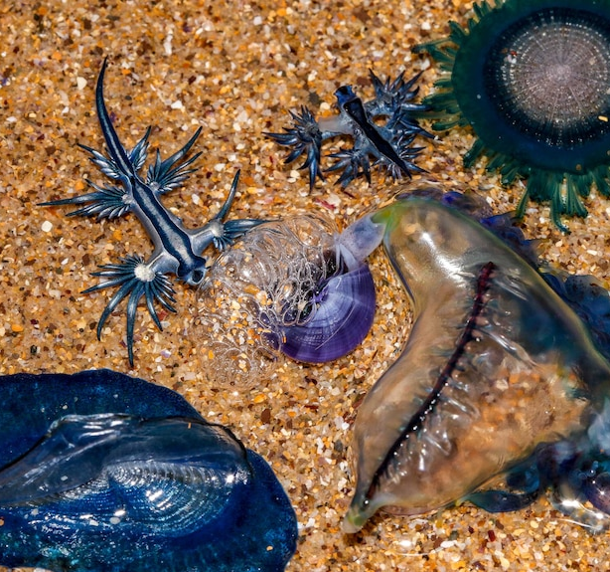
Predators, Prey and Strandings
An IBM approach to modelling the Blue Fleet
Joop Sassen
Notes:
Good morning everyone and thanks for joining!. My project involved modelling the blue fleet, a community of marine organisms that lives on the ocean surface.

Slide 2
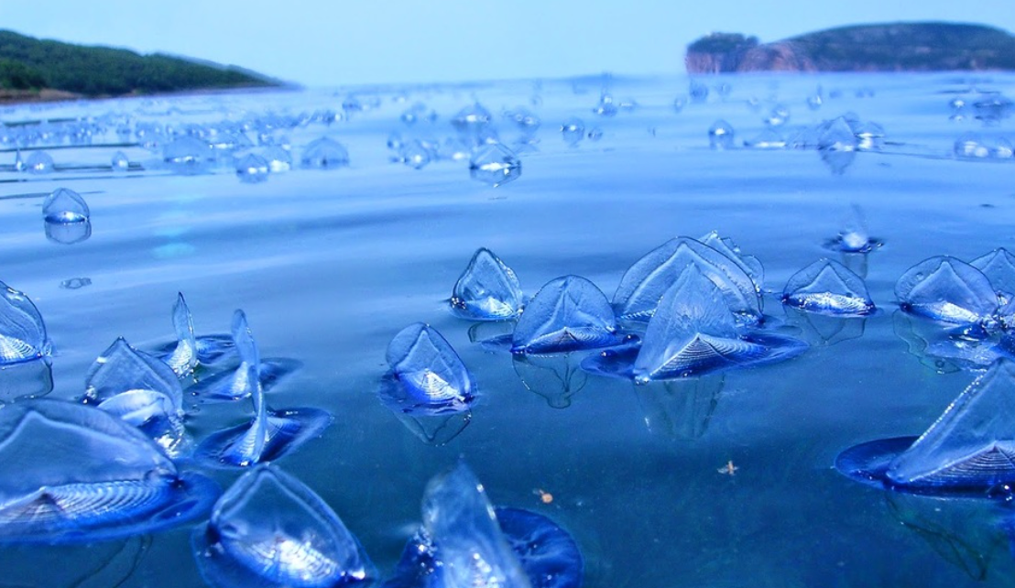
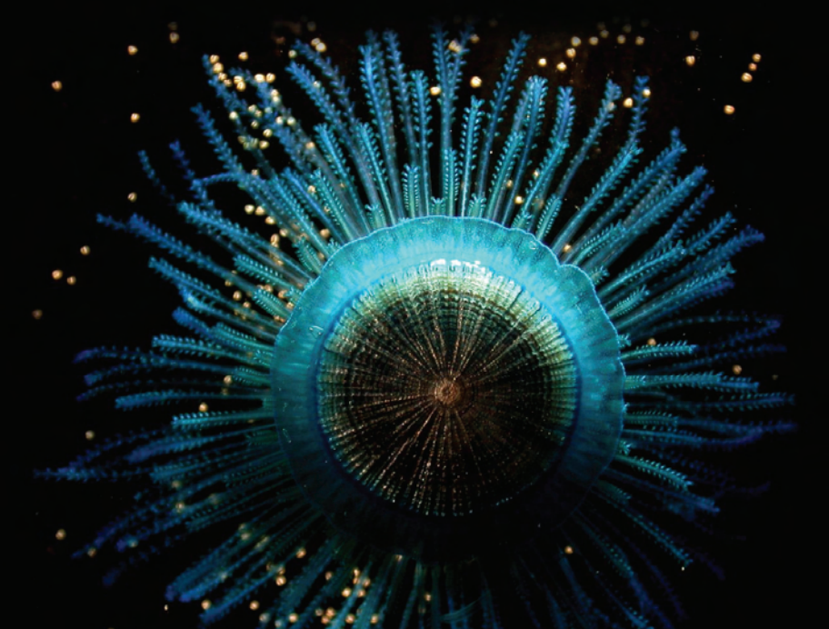
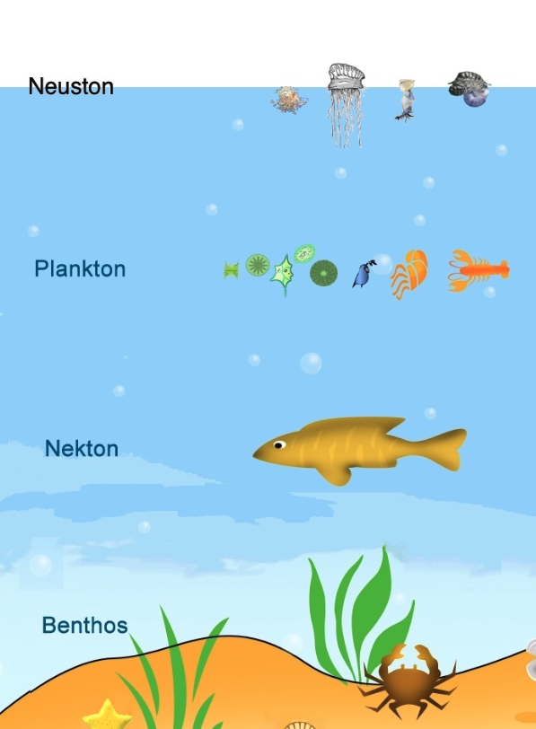
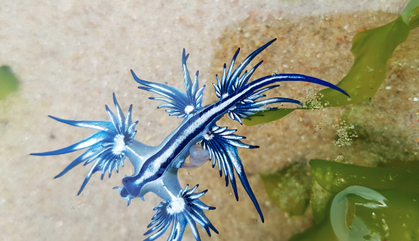
Drifting in the wind AND CURRENTS
Life at the surface – The Blue Fleet and the Neuston
Notes:
So, first I’d like to tell you a little bit about the Blue fleet. As I said, it’s a community of marine organisms that live at the ocean’s surface – which makes them part of the neuston. The animals that make up the blue fleet include cnidarians, such as these two pictured here, and several species of molluscs, such as the blue dragon, featured here. Now, being neustonic, these animals are essentially moved around by winds and currents. However, some cnidaria have developed sail-like structures, which gives them some rudimentary form of control over their movement.

Slide 3
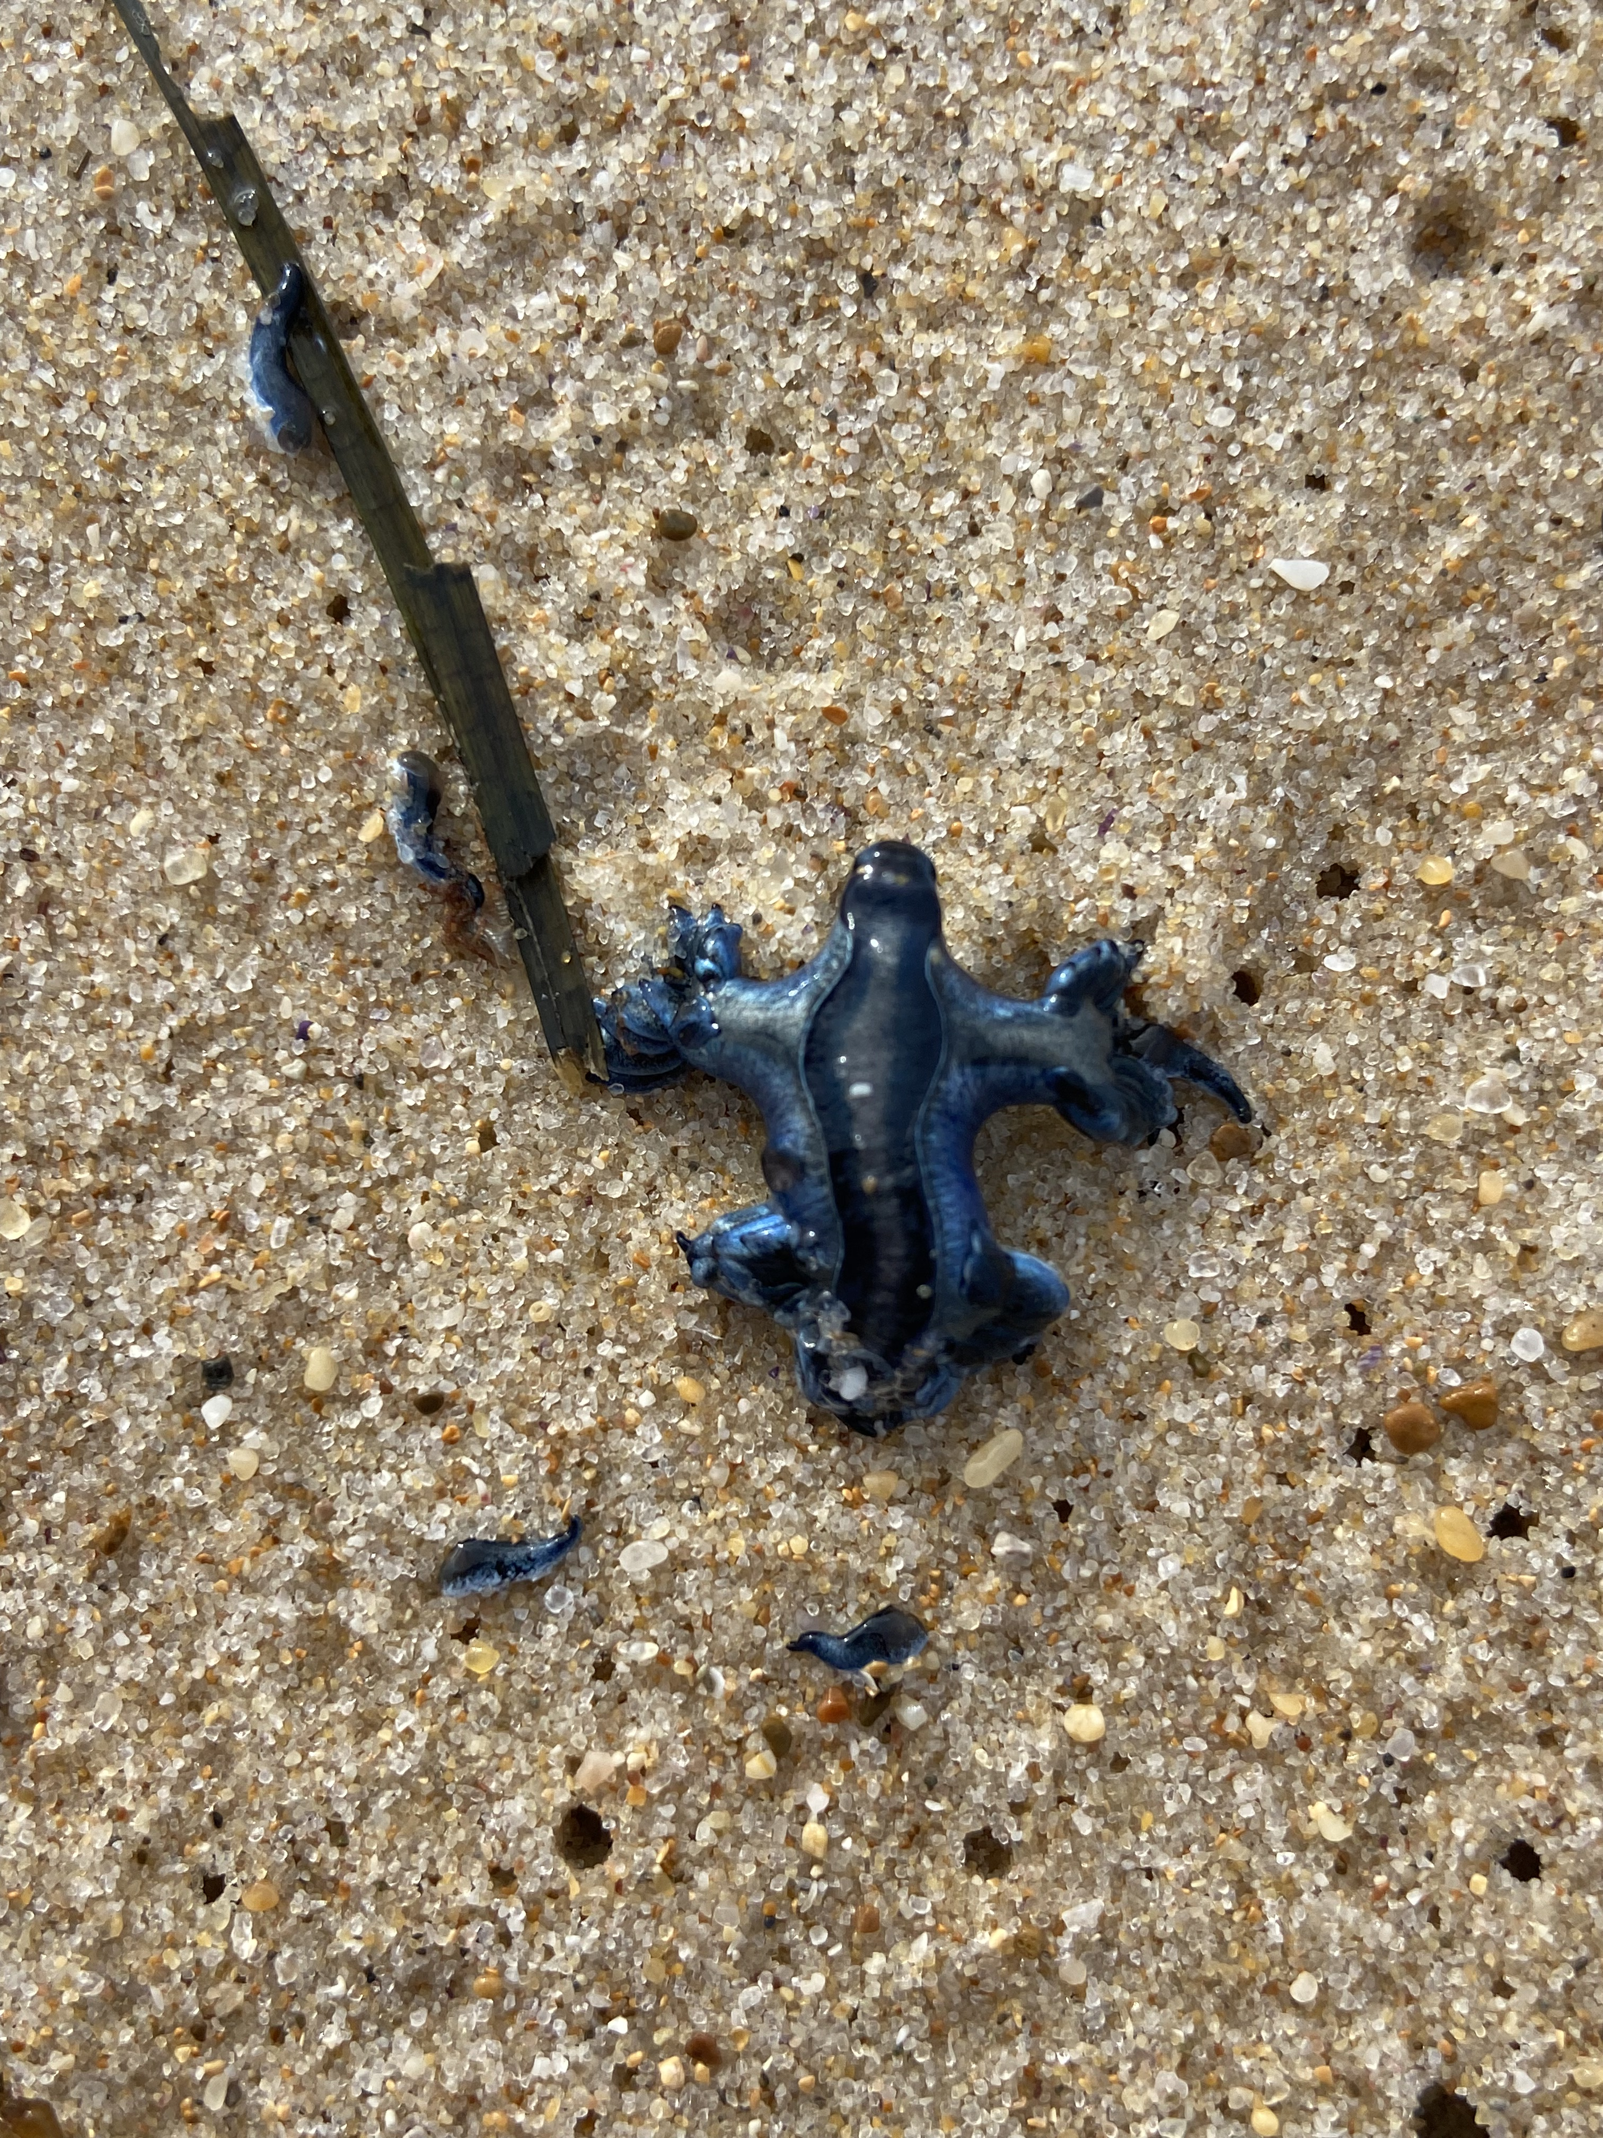
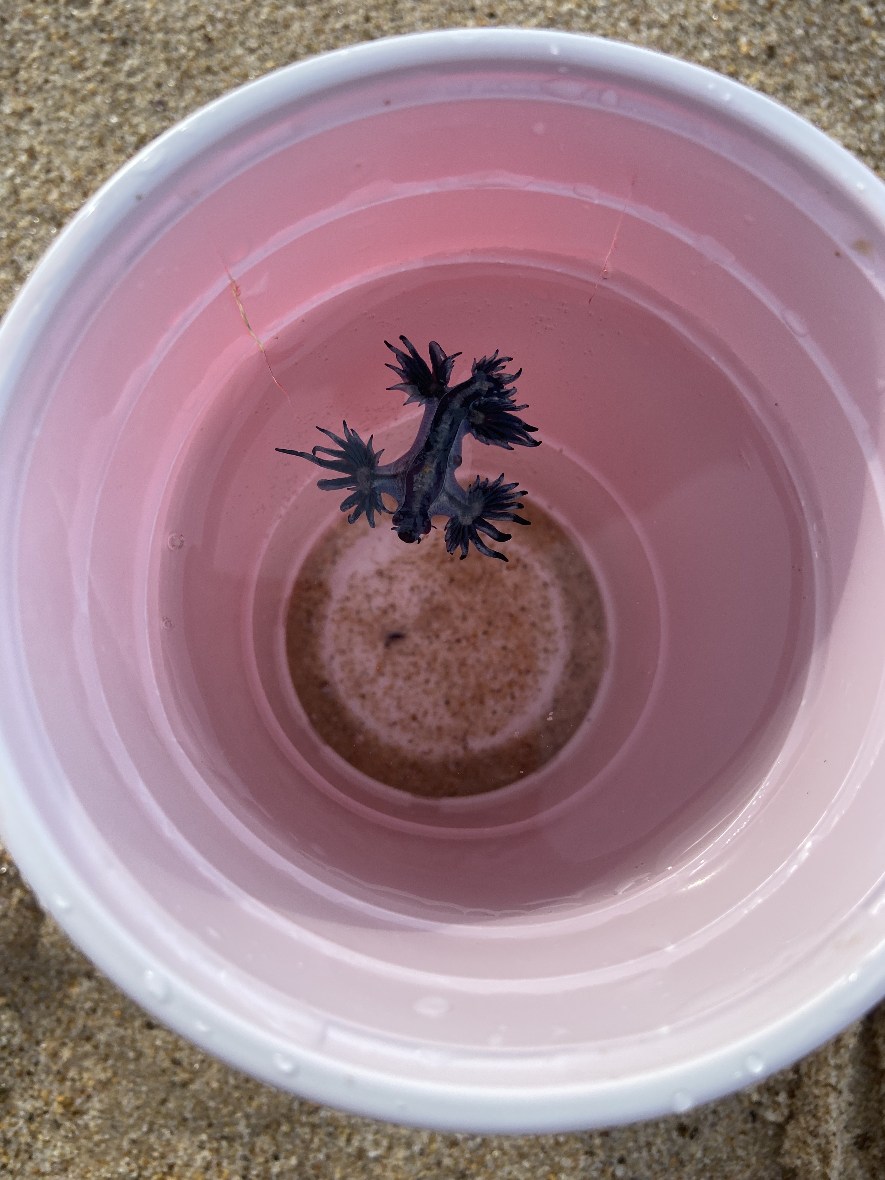
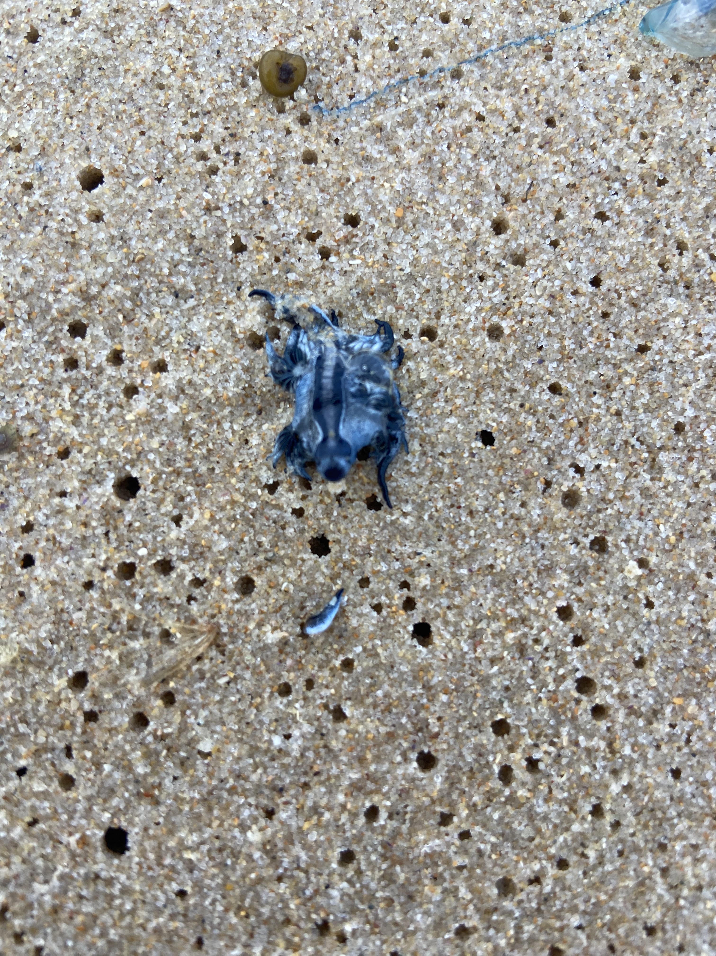
A THOUGHT-PROVOKING find
Why do some species wash up in isolation?
How does a poor swimmer find prey on the open ocean?
Notes:
Now, a couple of months ago, I was up at the central coast for a holiday and the wind was blowing very hard. The next morning, I went for a walk on the beach and found 100’s of blue dragons, as well many bluebottles. This was the first time I saw the blue dragon washed up, but I had seen heaps of bluebottles before. Two questions popped up into my mind – 1. Why do some species of the blue fleet wash up tin isolation, but not always? Could this be due to their different morphologies? And 2. How does this blue dragon, which actually is a predator of bluebottles, find prey if it can’t really swim that well – is it all based on random encounters?

Slide 4
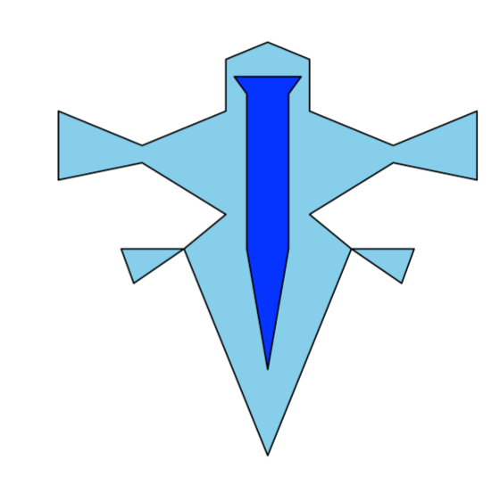
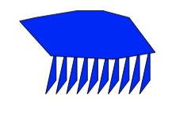
Building the model: the agents
Glaucus atlanticus
The ‘Blue Dragon’
Physalia physalis
Bluebottle
Notes:
So, to try and answer these questions, I built an individual-based model simulating the movement of two species in the blue fleet, Glaucus atlanticus and physalia physalis, in an environment emulating the east coast of Australia.. I want to point out that the bluebottle comes in two variations, left and right sailed. The wind will blow these in opposite directions of each other, about 50 degrees east and west of the prevailing wind.

Slide 5
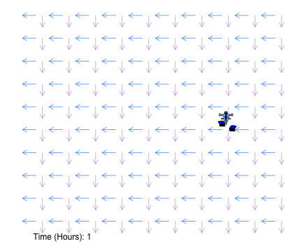
Physically-driven movement
Large fluctuations in direction, speed follows daily cycle
Movement is a function of speed and direction of wind and currents.
Small fluctuations in Speed and direction
Notes:
So the movement of the indiviudals has two parts. The first is physically driven movement: the effect of wind and currents. Wind speed follows somewhat of a daily cycle, so I built a custom function to simulate that – which looks something like this. Wind direction is more challenging, because it is quite unpredictable. I chose to set a dominant wind direction, and then let the model change the direction in small steps, stochastically. For currents, speed and direction are more stable. I allowed them both to vary stochastically within predetermined ranges, basing that on the literature.
So, that gives something like this! Glaucus is moving quite slow here, probably because the current is relatively weak. Also note the two glaucus going in opposite directions. The individuals can move through continuous space, and the area is divided into grid cells with associated values for physical parameters.

Slide 6
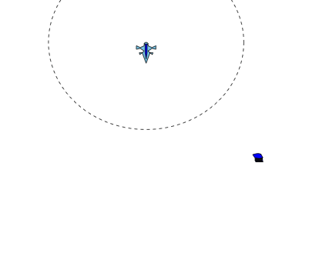
BEHAVIOURAL-driven movement
Biological parameters of predatory behavior are poorly studied.
Glaucus possibly capable of some powered movement and chemodetection of prey.
Notes:
The second part of movement is the behavioural movement. Now as I said, these animals don’t really move at all. However, it is believed that glaucus could be capable of limited directed movement towards prey. I’ve seen them try and swim myself – it is very weak, but they can move themselves. Experiments have also shown that glaucus can sense their prey using chemodetection. So, you could then imagine a little hunter, moving towards prey like shown here. These capabilities have been built in to the model: a glaucus will lock on and pursue prey at a given speed within its detection zone.

Slide 7
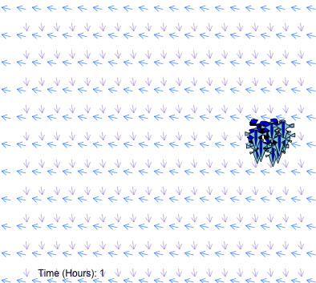
A single model run
500 hours
Strength and direction of physical forces stochastic
Individual response to physical forces subject
to variability (e.g. due to size, waves)
250 Glaucus and variable densities of Physalia
100km x 10km grid
Notes:
So, those are the components, and that gives you something like this. Now, A single model run lasts for 500 hours, or iterations. The physical forces are stochastic and each individual will respond slightly different to the force. For each simulation, the starting position of the individuals is randomly assigned on the 100kmx10km grid. We always have 250 glaucus, and we vary the number of physalia based on what we’re trying to find out. And lastyl, The beach is simply a straight line at x=1, once individuals cross this they are considered ‘beached’.

Slide 8

Simulating the blue fleet
Beaching
32 Model Runs
Stochastic wind and currents
Total: 32 Simulations
Total: 3 x 50 Simulations
1 Simulation = 500 hours
v
Sample 50 values for Chemo-detection ranges
and Swimming speeds between 0 – 20 meters
(Latin Square Design)
3 sub-models with prey density of
1, 3 and 5x predator densities
Predator Behavior
Notes:
So then, to answer our questions, we ran a few different types of simulations. Firstly, to investigate beaching probabilities, we ran 32 simulations of the model. To examine predator behaviour, we sampled 50 values for chemodetection range and swimming speeds of glaucus, using a latine square design. We then ran these simulations with three different prey densities, 1,3 and 5 times the number of glaucus. This yieled 3x50 simulations.

Slide 9
MaiN RESULTS
Beaching Probabilities over time
Notes:
So, moving on to results. Here we have the beaching probabilities of different organisms over time. On the left, we have the blue dragons. Each line represents one simulation. It appears that glaucus will always end up on the beach, regardless of starting position. Perhaps this is because our grid only spans 10km wide, which is quite close to shore for an animal that is normally found far offshore.
Interestingly, there’s a different pattern for the bluebottles. The right-sailed individuals were very prone to beaching – whereas the left-sailed versions predominantly persisted. So this is some support for the hypothesis that separate orientations allows populations to survive beaching events.

Slide 10
MaiN RESULTS
Predator-Prey Interactions for varying behavioral parameters
Notes:
On to the hunting behaviour. On the y-axis we have the number of interactions per individual overt the simulation. An interaction is defined as an event that impacts the movement of Glaucus. Each datapoint represents one simulation. The colours represent different prey densities. We see on the left graph that interactions increase with chemodetection range. This makes sense, as an animal that can sense further is likely to sense more prey. However, we see that there is no relationship between speed and interactions – even at high swimming speeds there is no sign that glaucus can increase the number of interactions with prey. So, sensed prey might drift away quicker then a glaucus can swim.

Slide 11
Concluding statements
The Blue Fleet: A loose assemblage or tightly woven web?
In our simulated ocean, bluebottles are less likely to strand
then Glaucus. Within bluebottles, left-sailed individuals are
less prone to beaching.
Do Glaucus need to move?
Higher Speed ≠ More Interactions
Notes:
So, to conclude, we’ve used an IBM to simulate two species of the blue fleet. We observe different beaching profiles for each species, and also within the bluebottle species. So, individuals are likely to drift off differently based on their morphology. However, it would be interesting to see what happens in a more realistic model featuring distinct currents and winds in different areas of the grid.
So, do glaucus need to move to find prey? Well, whilst increased sensing ability allows glaucus to detect more prey, I don’t think it will ever be able to move towards that prey over longer distances. The effect of physical forces trumps the small movements glaucus can make, so the number of interactions between predators and prey is not influenced by speed. It seems likely that glaucus just encounter prey randomly.
Thanks so much everyone. I hope that all made sense and I’d love to answer some questions or receive some feedback on any of this!

Slide 12
rEFERENCES
Bourg, N., Schaeffer, A., Cetina-Heredia, P., Lawes, J. C., & Lee, D. (2022). Driving the blue fleet: Temporal variability and drivers behind bluebottle (Physalia physalis) beachings off Sydney, Australia. Plos one, 17(3), e0265593.
Grove, S. (2010). Blow-ins from the Blue Fleet. The Tasmanian Naturalist, 132, 25-34.
Helm, R. R. (2021). Natural history of neustonic animals in the Sargasso Sea: reproduction, predation, and behavior of Glaucus atlanticus, Velella velella, and Janthina spp. Marine Biodiversity, 51(6), 99.
Lee, D., Schaeffer, A., & Groeskamp, S. (2021). Drifting Dynamics of the Bluebottle. Ocean Science Discussions, 2021, 1-21.
Valdés, Á., & Campillo, O. A. (2004). Systematics of pelagic aeolid nudibranchs of the family Glaucidae (Mollusca, Gastropoda). Bulletin of Marine Science, 75(3), 381-389.

